Slide 1
Man-in-the-Middle Attacks
Jonathan Rethorn
EECS 4770
12/11/09

Slide 2
Outline
Overview of MITM structure
The “Pineapple”
Sniffing with Wireshark for unencrypted connections
Session hijacking using cookies w/ Hamster & Ferret
SSLstripping w/ SSLstrip
Prevention
The Future
Questions

Slide 3
MITM
Attacker inserts himself between the client and the client’s destination
Passes traffic between source and destination and can potentially modify the traffic in the process
One popular method is ARP poisoning

Slide 4


The Hardware
Laptop running BackTrack 4
Fonera router (8MB ram) flashed with OpenWRT

Slide 5

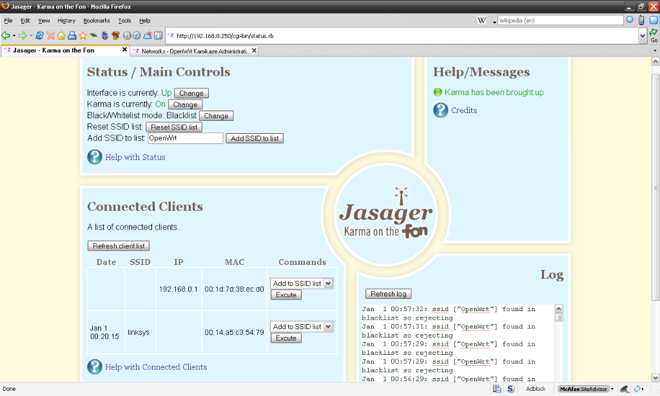
Jasager
Version of “Karma” for the Fon router
Responds to SSID broadcasts
Modularly written
AJAX web interface
Draws the victims in

Slide 6
Setting it Up
Configure DHCP and iptables on laptop
Connect router to laptop

Slide 7
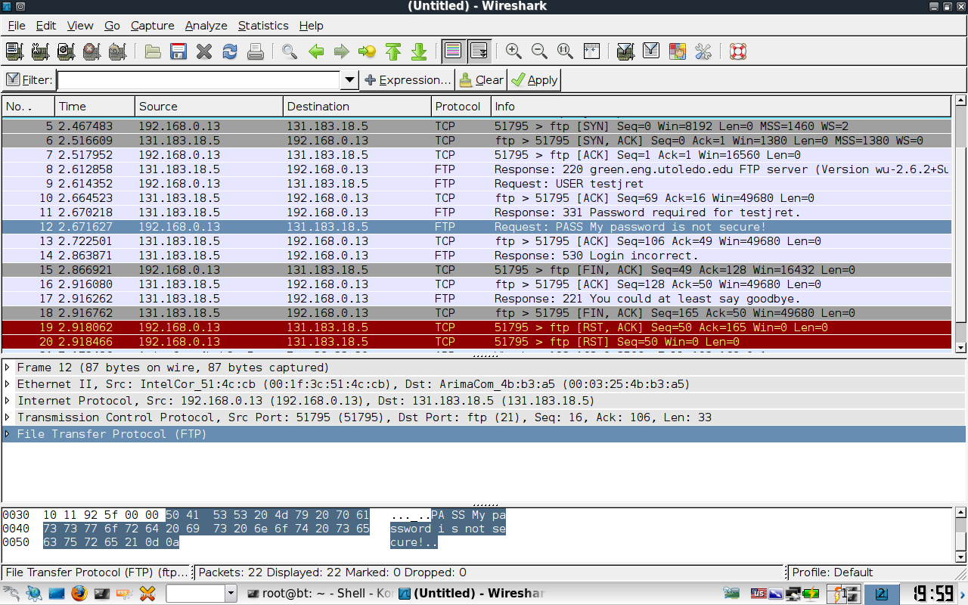
Sniffing for Plaintext
Once the victims connect, the MITM session is established
Open Wireshark and start sniffing the packets
Anything sent plaintext is readable

Slide 8
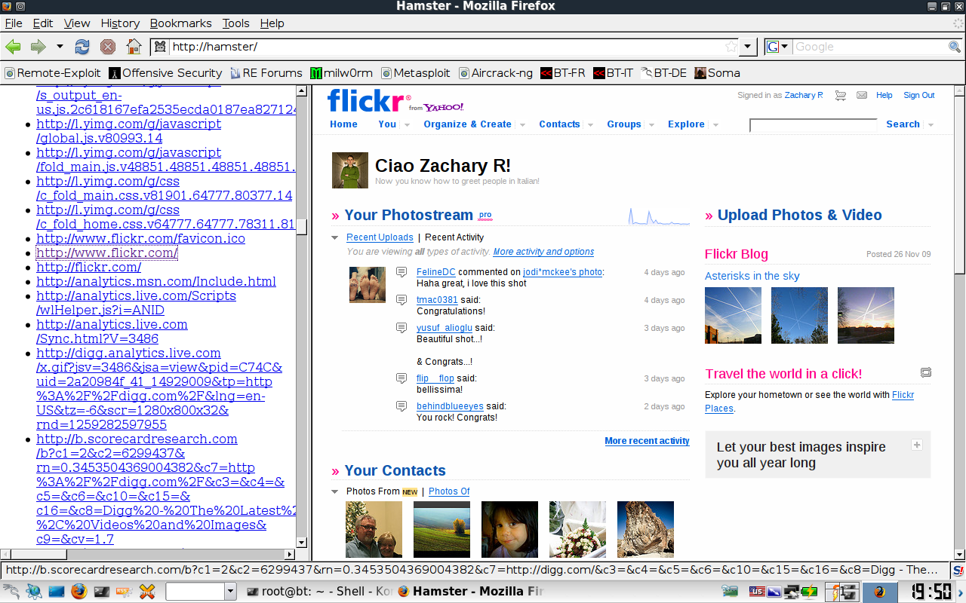
SideJacking with Hamster
Capture cookies
Web interface for injecting
Save dumps from Wireshark for later analysis

Slide 9
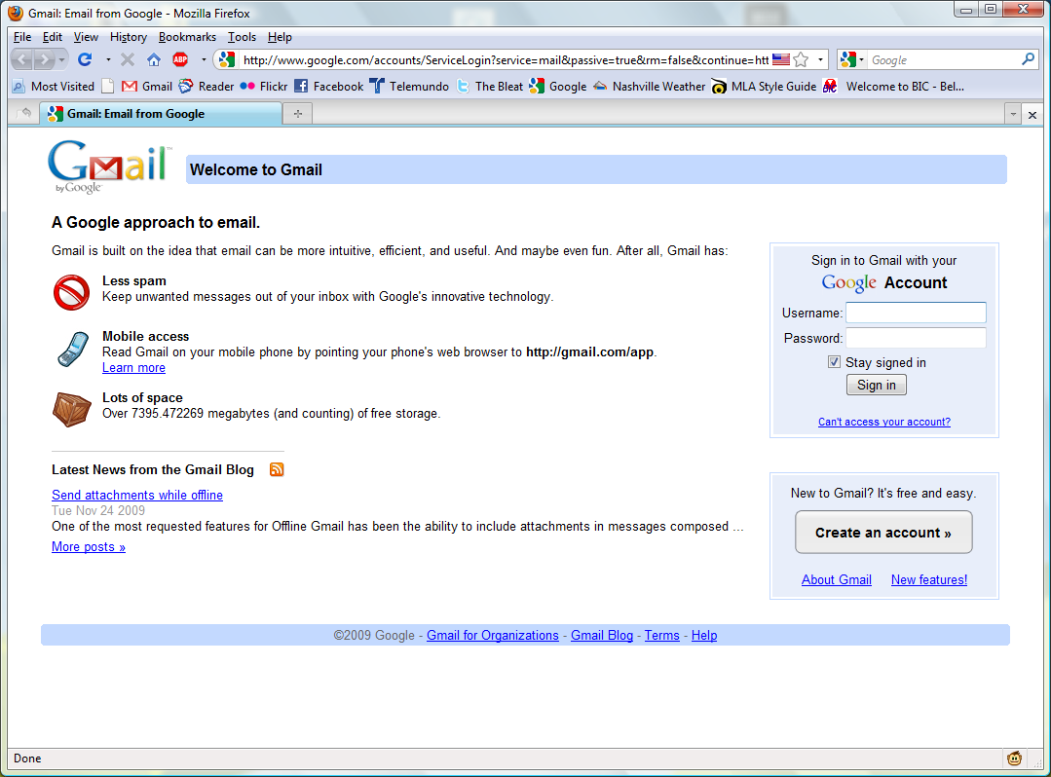
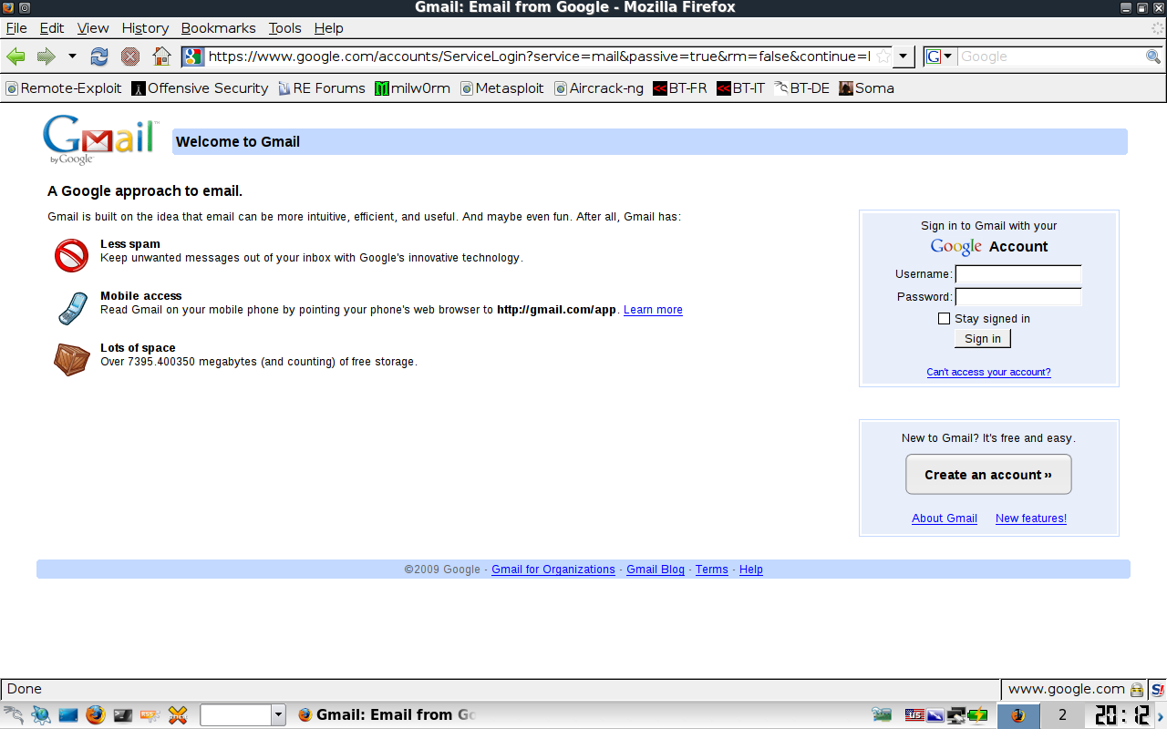
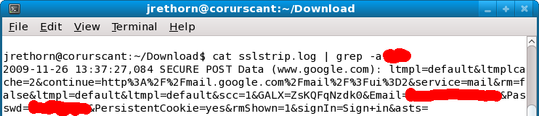
SSLStrip
Transparently watch for HTTPS links and redirect them to look-alike HTTP links
Supports favicon insertion

Slide 10
Prevention
Requires vigilance on the part of the end user
Questions should be raised when connecting to wireless access points
Tunnel all traffic!

Slide 11
The Future
The projects / software are all open source
Jasager is a community driven project
Evilgrade / Metasploit on the Fon

Slide 12
Questions?

